Slide 1
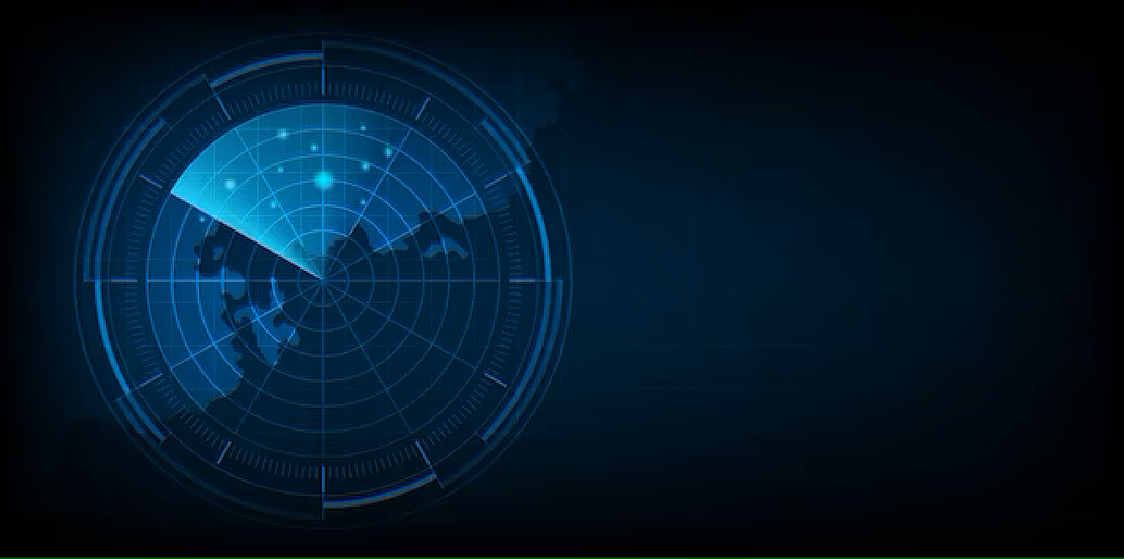
Gesture Recognition
With Radar
& Applications
EE 371 Independent project
Nishant Mahawar (12041000)
Priya Tomar (12041140)
Lahari Sreeja (12041570)
Sakshi Saraswat (12041130)

Slide 2
OBJECTIVE
Gestures are a standard means of communication used by people to exchange an information between each other. Thus, it would also be natural for people to use them to communicate with computers.
The goal of the hand gesture recognition based on a radar sensor is to improve a human-machine interface, while taking into consideration privacy issues of camera sensors.
In addition, the system has to be deployable on a low-power microcomputer for the applicability in broadly defined IoT and Smart home solutions.

Slide 3
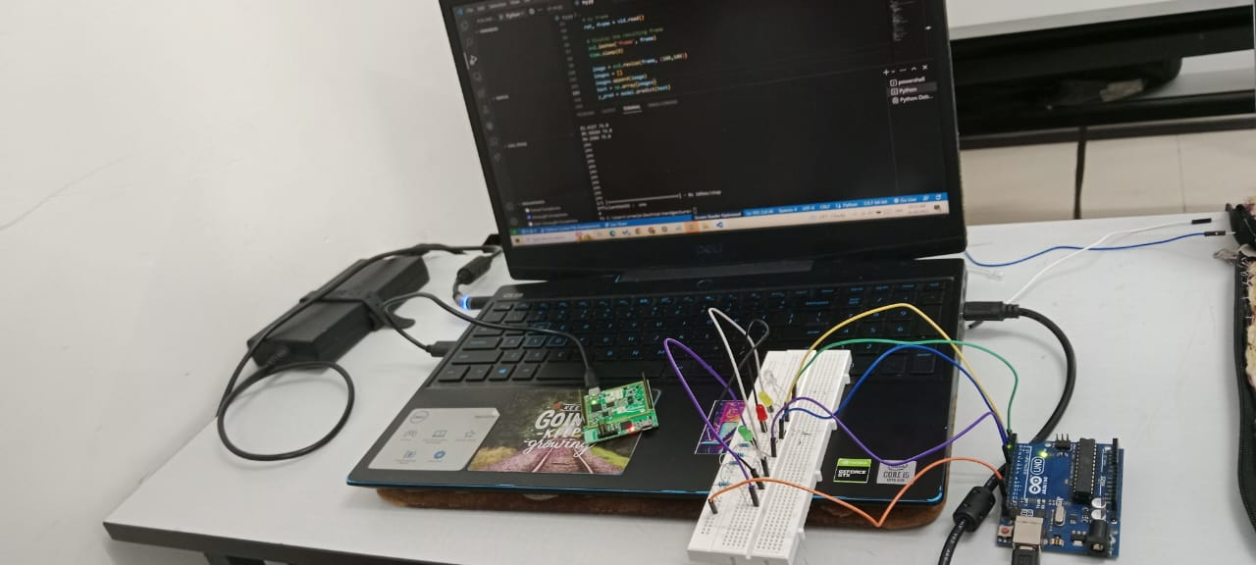
COMPONENTS USED
Radar - Infineon distance2Go Sensor
Arduino Uno
LED
Breadboard
Connecting Wires

Slide 4
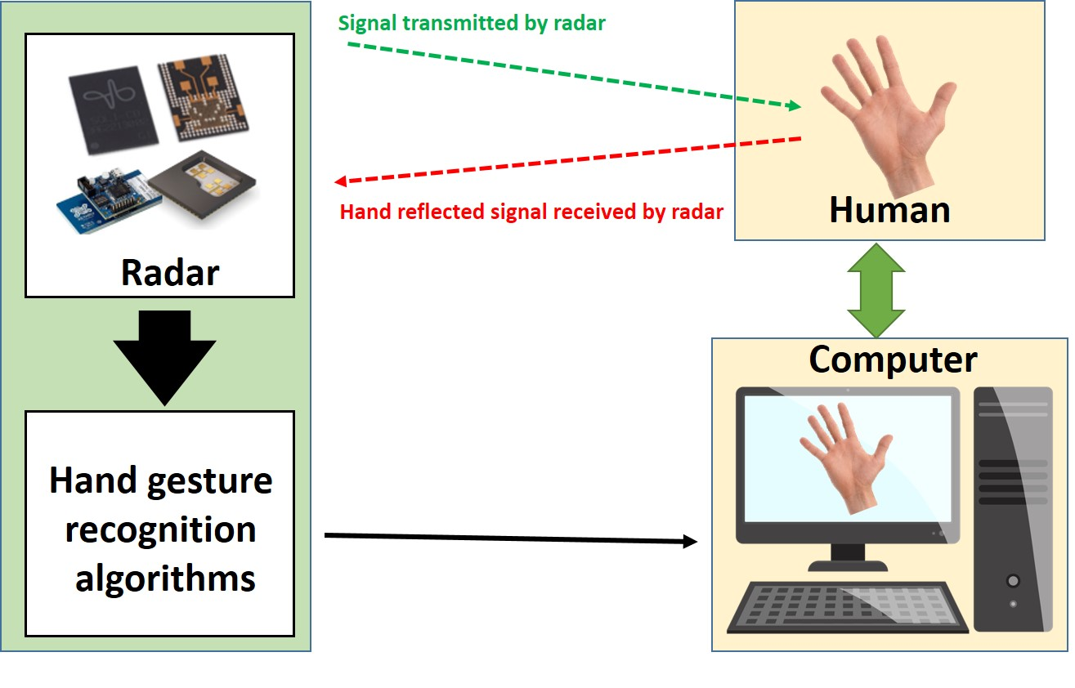
WORKING

Slide 5
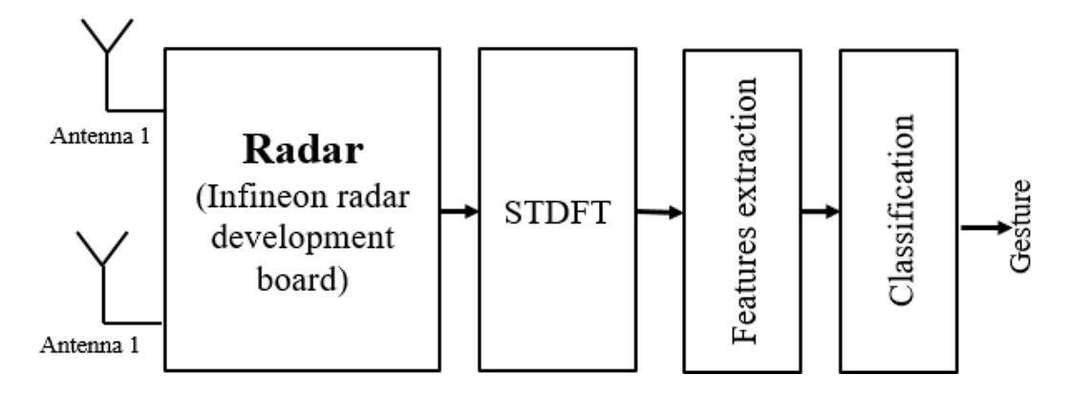

Slide 6
Hand Gesture Recognition using Machine Learning
Images in the dataset are augmented, resized,shuffled and then training and validation data sets are created accordingly.
These images along with their labels are fed into Convolutional Neural Network(CNN)
EfficientNet-B3 is a type of CNN architecture that is optimized for both accuracy and efficiency.
The models are trained and the parameters/weights are saved in a h5 file which is used in final detection during livestream.

Slide 7
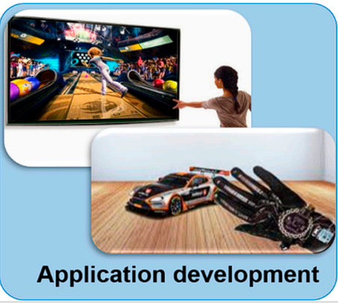
APPLICATIONS
Automotive Industry: The use of hand gestures could replace traditional car controls and provide a safer, hands-free driving experience.
Healthcare Industry: Hand gesture recognition using radar could aid in the development of non-invasive medical equipment, such as prosthetic devices or rehabilitation tools for patients with limited mobility.
Gaming Industry: Gesture recognition using radar could provide a
more immersive gaming experience by enabling players to control the
game with hand gestures.
Robotics Industry: Hand gesture recognition using radar could enable
robots to interact with humans in a more natural and intuitive way, making
them more useful and accessible for a wide range of tasks.

Slide 8
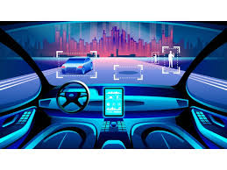

Slide 9
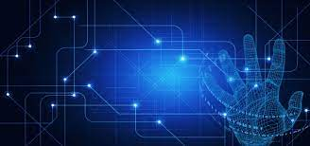
Thank you

